Slide 1

Phase 1, Module 6: Control Flow & System Automation
Khyber AI Systems Engineer (KASE)
Welcome to Module 6. Until now, our code runs top-to-bottom and stops. Today, we give our systems the ability to make decisions and automate repetitive tasks. This is where your code becomes a 'System’
Presented By: Zaryab Ahmad

Slide 2
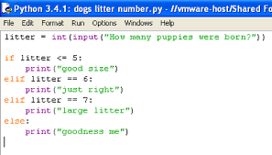

Conditionals (The System Router)
$$if, elif, else$$
The brain's routing mechanism.
$if$: The primary check.
elif: The secondary check (only runs if the first fails).
else: The default fallback (prevents system crashes).

Slide 3
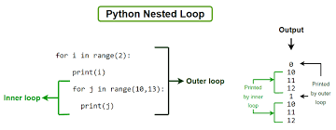
The for Loop (Batch Processing)
Predictable Automation
Use a for loop when you know exactly how much data you have.
Perfect for iterating through Lists (datasets) and Dictionaries (JSON).

Slide 4
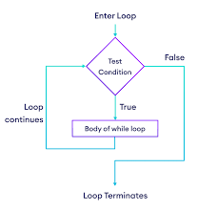
The while Loop (The Server Engine)
Unpredictable Automation & Retries
Use a while loop when you don't know when the task will end.
Danger: Infinite loops will crash your RAM.
AI Use Case: "Retry connecting to the database while the connection is False."

Slide 5
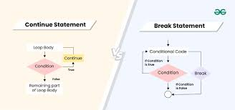


Compute Efficiency ($break$ & $continue$)
Saving GPU Cycles
$continue:$Skip this specific item, but keep the loop running. (e.g., skip a corrupted image).
break: Kill the loop entirely. (e.g., Target found, stop searching).

